Slide 1
Propositional Logic
CSE 2213 – Discrete Mathematics
Instructor: Md. Mohaiminul Islam

Slide 2
What is a proposition?
A proposition is a declarative sentence
It can be either true or false
It cannot be neither
It cannot be both
Example: Today is Sunday
It’s raining outside.

Slide 3
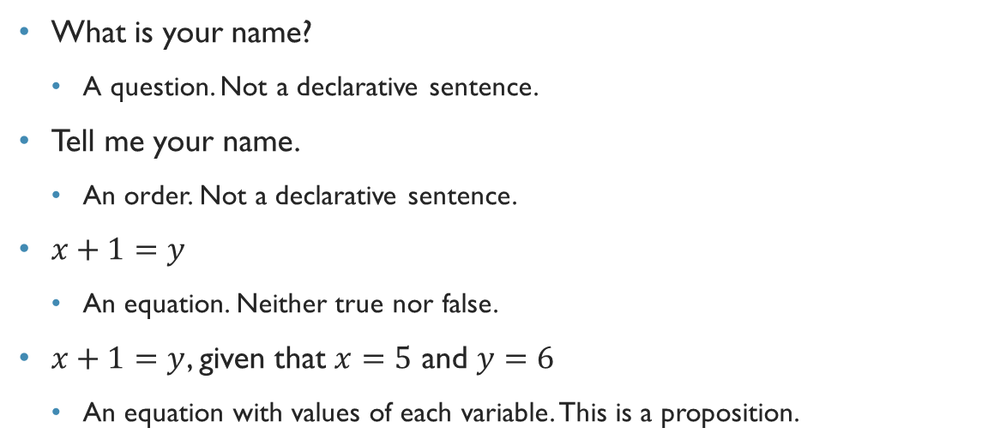
What is not a proposition?
What is your name?
A question. Not a declarative sentence.
Tell me your name.
An order. Not a declarative sentence.
$x+1=y$
An equation. Neither true nor false.
$x+1=y$, given that $x=5$ and $y=6$
An equation with values of each variable. This is a proposition.

Slide 4
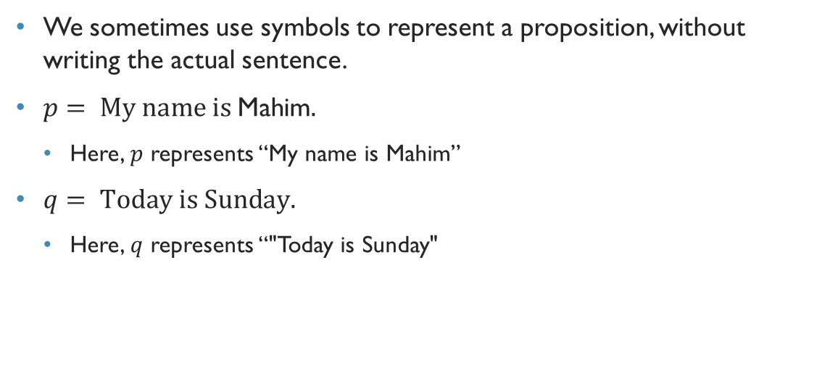
Proposition
We sometimes use symbols to represent a proposition, without writing the actual sentence.
$p= \text{My} \text{name} \text{is} \text{Mahim}\text{.}$
Here, $p$ represents “My name is Mahim”
$q= \text{Today} \text{is} \text{Sunday}\text{.}$
Here, $q$ represents “"Today is Sunday"

Slide 5
Compound propositions
My name is Mahim and I am a lecturer.
We can express this proposition as a combination of two propositions, along with a linker
Such linkers are – and, or, if, only if, if and only if

Slide 6
Logical Connectives
OR (∨)
AND (∧)
Negation/ NOT (¬)
Implication / if-then (→)
Biconditional (⇔)

Slide 7
Compound propositions
Consider the following proposition: My name is Mahim.
My name is not Mahim
Today is Sunday
Today is not Sunday
It’s not the case that today is Sunday.
It only negates the actual proposition
Such a proposition is called a negation

Slide 8
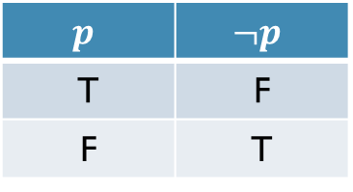
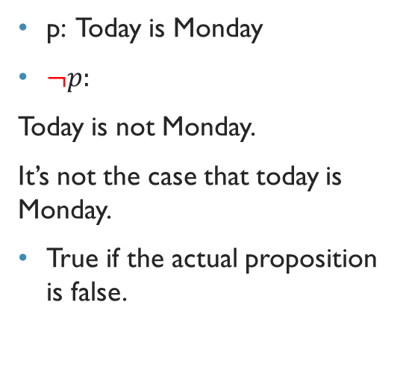
Negation
p: Today is Monday
$¬p:$
Today is not Monday.
It’s not the case that today is Monday.
True if the actual proposition is false.
$$p$$ | $$¬p$$
T | F
F | T

Slide 9
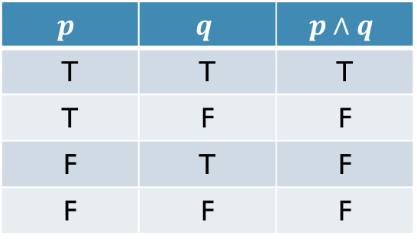
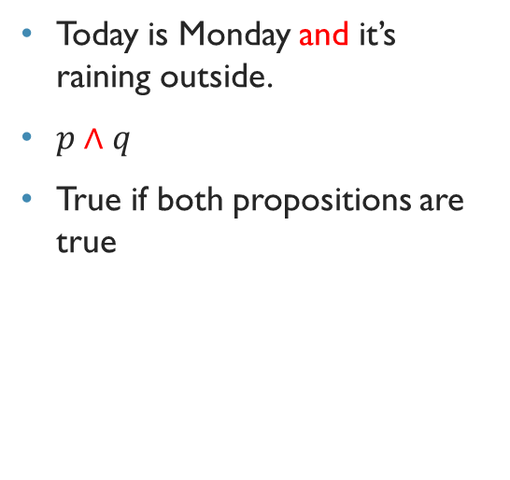
Conjunction
Today is Monday and it’s raining outside.
$p∧q$
True if both propositions are true
$$p$$ | $$q$$ | $$p∧q$$
T | T | T
T | F | F
F | T | F
F | F | F

Slide 10
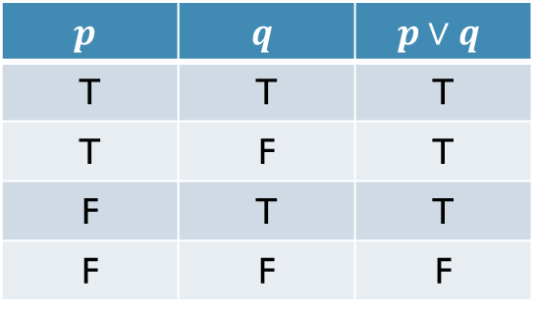

Disjunction
Today is Monday or it’s raining outside.
$p∨q$
True if any proposition is true
$$p$$ | $$q$$ | $$p∨q$$
T | T | T
T | F | T
F | T | T
F | F | F

Slide 11
Implication/CondiTional statement
If it rains, then I will stay home.
Let P and Q be propositions.
P: It rains
Q: I will stay home
P is called premise
Q is called conclusion/consequence
P | Q | P → Q
T | T | T
T | F | F
F | T | T
F | F | T

Slide 12
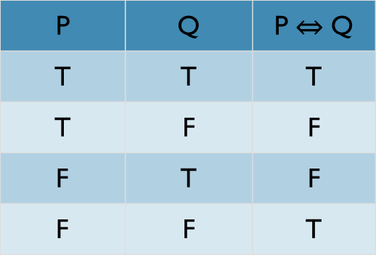
Biconditional
P: You can take the flight
Q: You buy a ticket
You can take the flight if and only if you buy a ticket.

Slide 13
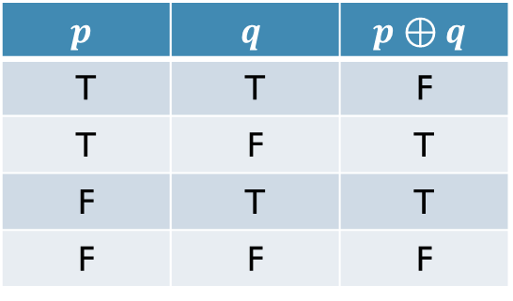
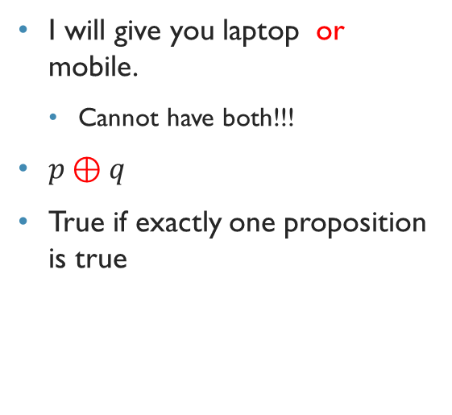
A special type of disjunction – Exclusive-or
I will give you laptop or mobile.
Cannot have both!!!
$p⊕q$
True if exactly one proposition is true
$$p$$ | $$q$$ | $$p⊕q$$
T | T | F
T | F | T
F | T | T
F | F | F

Slide 14
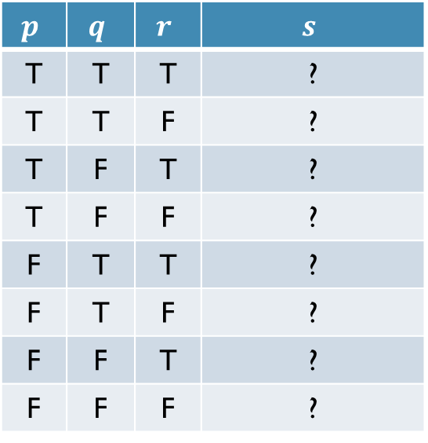
Truth tables of compound propositions
The propositions of a compound statement may have different truth values
In a truth table, we consider all truth values of the propositions, and find out the truth value of the compound one
$$p$$ | $$q$$ | $$r$$ | $$s$$
T | T | T | ?
T | T | F | ?
T | F | T | ?
T | F | F | ?
F | T | T | ?
F | T | F | ?
F | F | T | ?
F | F | F | ?

Slide 15
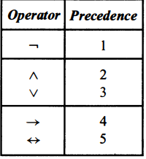
Logical Operator Precedence

Slide 16

Truth Table
Construct truth table for the following statements
Q$∨$(¬Q∧¬P)
(A$∨$B) ∧ ¬ (B $∨$ C)
(P $∨$ ¬Q) ∧ (¬ P $∨$ Q)

Slide 17
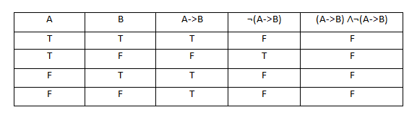
(A→B)∧¬(A→B)

Slide 18

Exercise
Construct a truth for each of the following compound propositions.
(A→B) ⇔ ¬(A $⊕$B)
P → Q∧(¬Q∧¬P)
P ∧ ( Q ⇔ R)

Slide 19
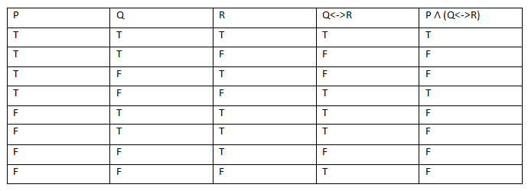
P ∧ ( Q ⇔ R)

Slide 20
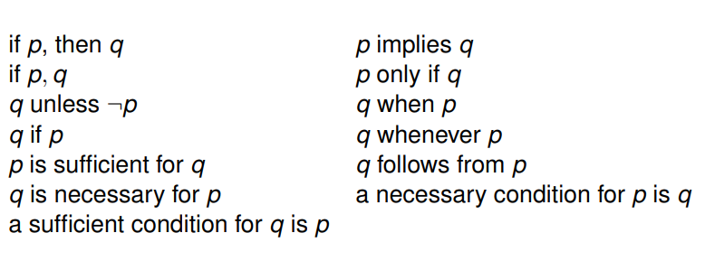
Different Ways Of Expressing Conditional Statement

Slide 21
BiConditional Statement
Different ways to express p ⇔q :
p if and only if q
p iff q
p is necessary and sufficient for q
if p then q, and if q,then p

Slide 22
Inverse, Converse, Contrapositive
q → p is the converse of p → q
¬q → ¬p is the contrapositive of p → q
¬ p → ¬ q is the inverse of p → q
Find the converse, inverse, and contrapositive of "The football team wins whenever it is raining.“
Rewriting the sentence : "If it is raining, then the football team wins."
q → p: If the football team wins, then it’s raining.
¬q → ¬p: If the football team doesn’t win, then it’s not raining
¬ p → ¬ q: If it’s not raining, then the football team doesn’t win.

Slide 23
Translating English sentences
How can this English sentence be translated into a logical expression? “ If you submit the report, then you will get bonus mark.
Let p and q be a proposition:
p: You submit the report
q: You get bonus mark
Logical expression: p →q

Slide 24
Translating English sentences
Chapter 1: 1.1
Exercise: 7, 9, 10

Slide 25
Translating Logical expression to English
Chapter 1: 1.1
Exercise : 4, 5, 6, 8

Slide 26
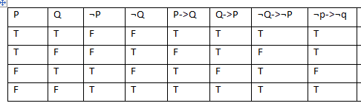
Find the Truth table : p → q, q → p ,¬q → ¬p , ¬ p → ¬ q

Slide 27
Practice Problem
Find the inverse, converse and contrapositive of the following sentence.
I come to class whenever there is going to be a quiz.

